Slide 1




Lesson 1: Core Concepts in INFO 5731
Haihua Chen
Assistant Professor, Data Science
9402688589
Haihua.chen@unt.edu

Slide 2
Lesson 1-6
Core concepts in Python
Natural language processing
Web scarping
Corpus
Data Quality
Data wrangling/ preprocessing/ cleaning
Tokenization
Normalization
Stemming
Lemmatization
Stop Words
Parts-of-speech (POS) Tagging
Statistical Language Modeling
Bag of Words
n-grams
Regular Expressions
Zipf's Law
Feature Extraction/ engineering
tf-idf
Word Embedding

Slide 3
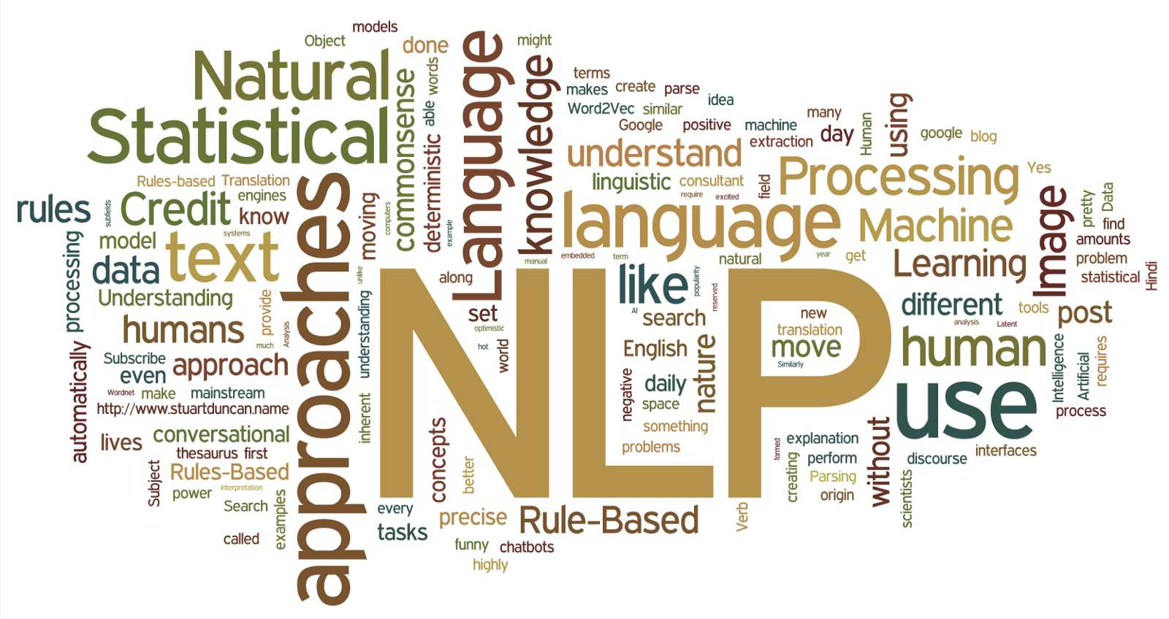
Natural language processing (NLP)
Natural language processing (NLP) concerns itself with the interaction between natural human languages and computing devices.
https://hpccsystems.com/resources/understanding-natural-language/
Notes:
Data: Text, conversational (speech)
Automatically processing
Machine learning, AI
Linguistic: Computational linguistics

Slide 4
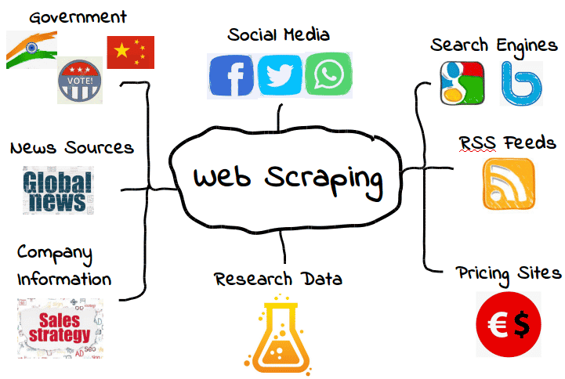
Web scraping
Web scraping is the process of using bots to extract content and data from a website
https://kinsta.com/knowledgebase/what-is-web-scraping/

Slide 5
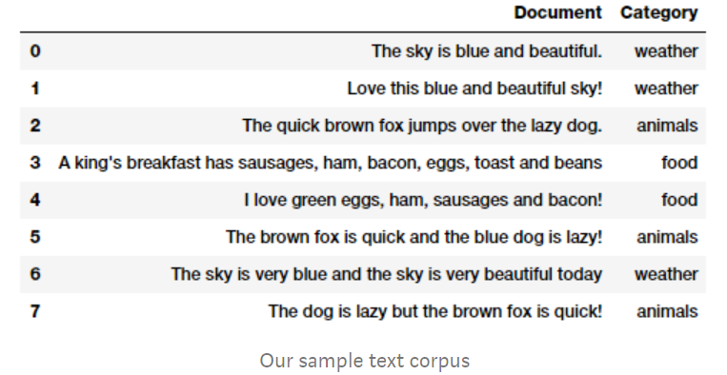
Corpus
In linguistics and NLP, corpus (literally Latin for body) refers to a collection of texts. Such collections may be formed of a single language of texts or can span multiple languages -- there are numerous reasons for which multilingual corpora (the plural of corpus) may be useful. Corpora may also consist of themed texts (historical, Biblical, etc.).

Slide 6
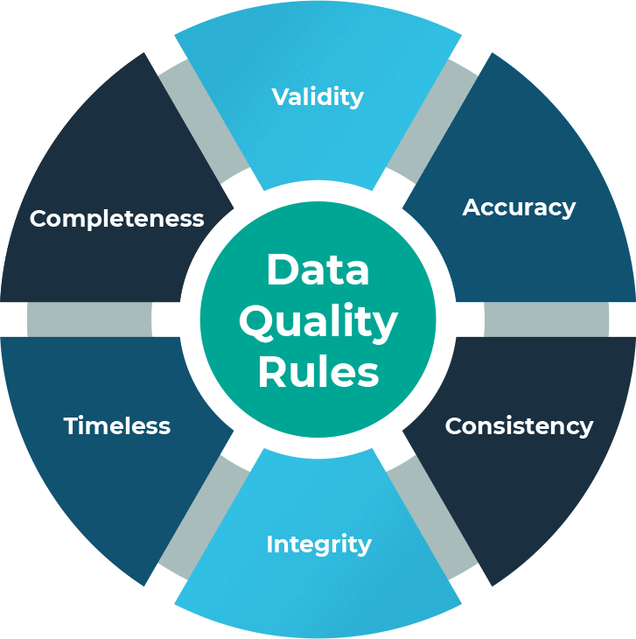
Data Quality
Data quality is a measure of a data set's condition based on factors such as accuracy, completeness, consistency, reliability, validity, and others.

Slide 7
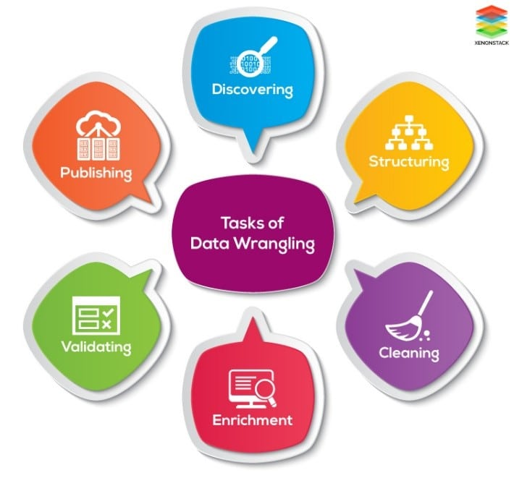
Data Wrangling
Data wrangling is the process of transforming and structuring data from one raw form into a desired format with the intent of improving data quality and making it more consumable and useful for analytics or machine learning.

Slide 8
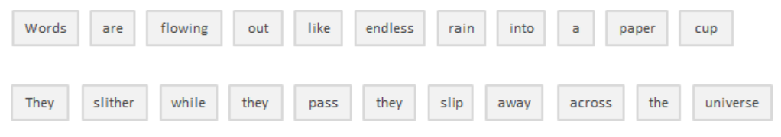
Tokenization
Tokenization is, generally, an early step in the NLP process, a step that splits longer strings of text into smaller pieces or tokens.

Slide 9
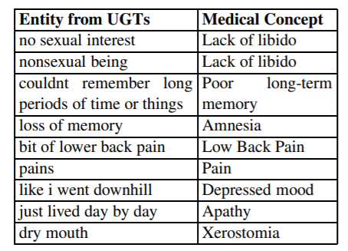
Normalization
Normalization generally refers to a series of related tasks meant to put all text on a level playing field: converting all text to the same case (upper or lower), removing punctuation, expanding contractions, converting numbers to their word equivalents, and so on.
Notes:
- converting all text to the same case. E.g. UPPer -> upper
- Removing punctuation
- expanding contractions: I’m -> I am
- converting numbers to their word equivalents: 10 -> ten num2words -> https://pypi.org/project/num2words/

Slide 10
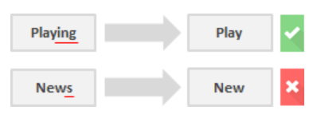
Stemming
Stemming is the process of eliminating affixes (suffixed, prefixes, infixes, circumfixes) from a word in order to obtain a word stem.
Notes:
- infix: add affix within the word such as bloody in abso-bloody-lutely
- A circumfix is an affix which has two parts, one placed at the start of a word, and the other at the end.

Slide 11
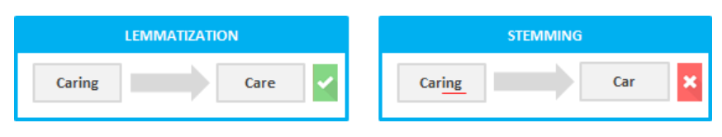

Lemmatization
Lemmatization is related to stemming, differing in that lemmatization is able to capture a word’s canonical forms based on its lemma. The process resolves words to their dictionary form (known as lemma), which requires detailed dictionaries so that the algorithm can look into and link words to their corresponding lemmas.
Notes:
While stemming chops off the end of a word, lemmatization captures a word's canonical form based on its lemma. This process resolves words to their dictionary form, known as a lemma. To perform lemmatization, detailed dictionaries are required, which the algorithm can use to link words to their corresponding lemmas.

Slide 12
Stop Words
Stop words are those words that are filtered out before further processing of text since these words contribute little to overall meaning, given that they are generally the most common words in a language.
An example of stop word list: https://gist.github.com/sebleier/554280

Slide 13
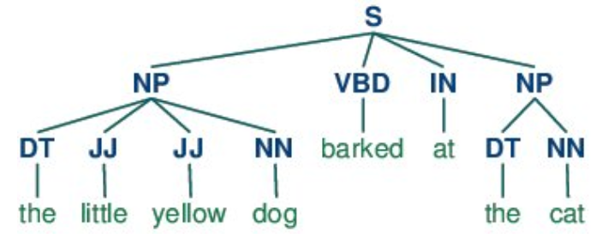
Parts-of-speech (POS) Tagging
POS tagging consists of assigning a category tag to the tokenized parts of a sentence. The most popular POS tagging would be identifying words as nouns, verbs, adjectives, etc.

Slide 14
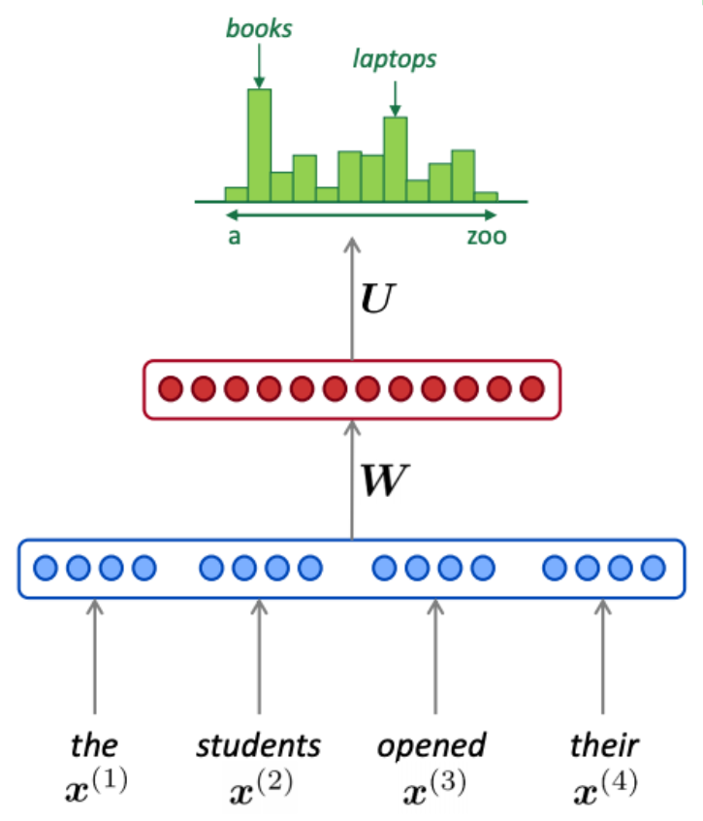
Statistical Language Modeling
Statistical Language Modeling is the process of building a statistical language model that is meant to provide an estimate of a natural language. For a sequence of input words, the model would assign a probability to the entire sequence, which contributes to the estimated likelihood of various possible sequences.
Notes:
- Statistical Language Models (SLMs) are one of the key techniques in NLP that allow computers to understand and generate natural language.
- SLMs are based on the idea that language is not a random collection of words but rather a system of rules and patterns.
- By applying statistical techniques to these patterns, SLMs can learn and predict the probability of certain words and phrases in a given context.
- The main idea behind SLMs is to use mathematical and statistical methods to model the probability distribution of sequences of words in natural language.
- Two types of Statistical Language Models: n-gram models and neural network-based models.

Slide 15
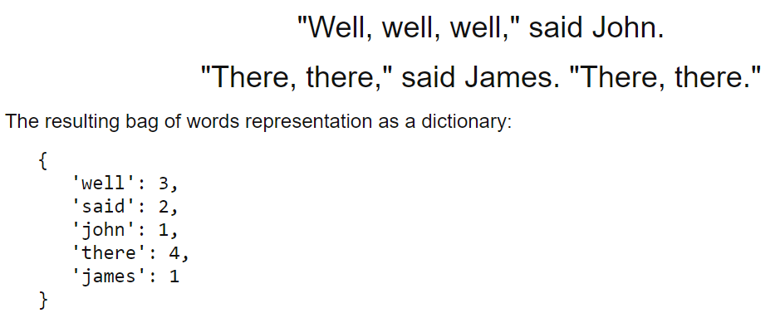
Bag-of-words
Bag of words is a particular representation model used to simplify the contents of a selection of text. The bag of words model omits grammar and word order but is interested in the number of occurrences of words within the text.

Slide 16
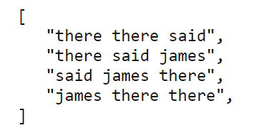
N-gram
n-grams is another representation model for simplifying text selection contents. As opposed to the representation of bag-of-words, n-grams modeling is interested in preserving contiguous sequences of N items from the text selection.

Slide 17
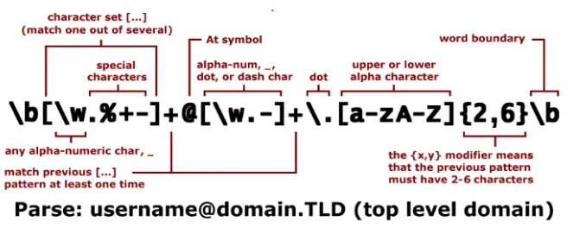
Regular Expressions
Regular expressions are a tried-and-true method of concisely describing patterns of text. A regular expression is represented as a special text string itself and is meant for developing search patterns on selections of text.

Slide 18
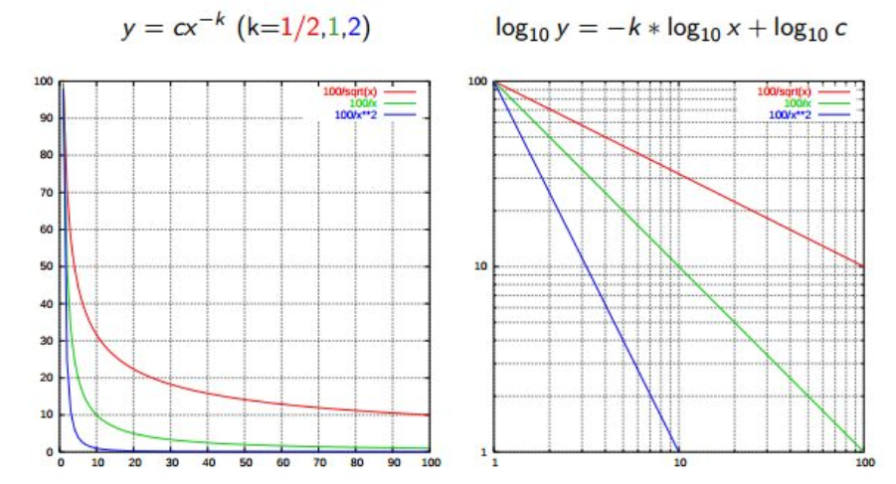
Zipf’s Law
Zipf's Law is used to describe the relationship between word frequencies in document collections. If a document collection's words are ordered by frequency, and y is used to describe the number of times that the xth word appears, Zipf's observation is concisely captured as y = cx-1/2 (item frequency is inversely proportional to item rank).
Notes:
Zipf's law: Modeling the distribution of terms

Slide 19
Feature Extraction/ Engineering
Feature extraction refers to the process of transforming raw data into numerical features that can be processed while preserving the information in the original data set.
Feature engineering is the process of selecting, manipulating and transforming raw data into features that can be used in supervised learning.
Feature selection involves identifying the most relevant features for the target variable and discarding the irrelevant ones
https://www.kaggle.com/discussions/questions-and-answers/388133

Slide 20
Tf-idf
tf-idf is a weighting system that assigns a weight to each word in a document based on its term frequency (tf) and the reciprocal document frequency (tf) (idf). The words with higher scores of weight are deemed to be more significant.

Slide 21
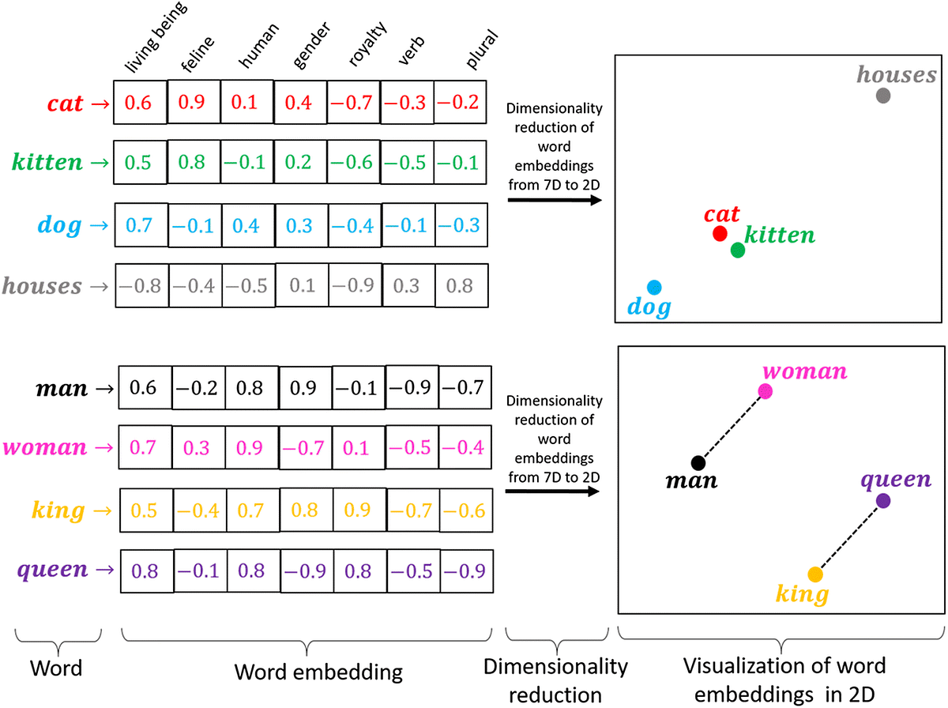
Word Embedding
Word embedding in NLP is an important term that is used for representing words for text analysis in the form of real-valued vectors. It is an advancement in NLP that has improved the ability of computers to understand text-based content in a better way. It is considered one of the most significant breakthroughs of deep learning for solving challenging natural language processing problems.
Different word embedding techniques

Slide 22
Lesson 7-11
Information Extraction
Name Entity Recognition
Similarity Measures
Syntactic Analysis
Semantic Analysis
Sentiment Analysis
Text Clustering
Topic Modeling
Text Classification
Machine Translation
Information Retrieval
Text Summarization
Large language models (LLMs)
Generative AI

Slide 23
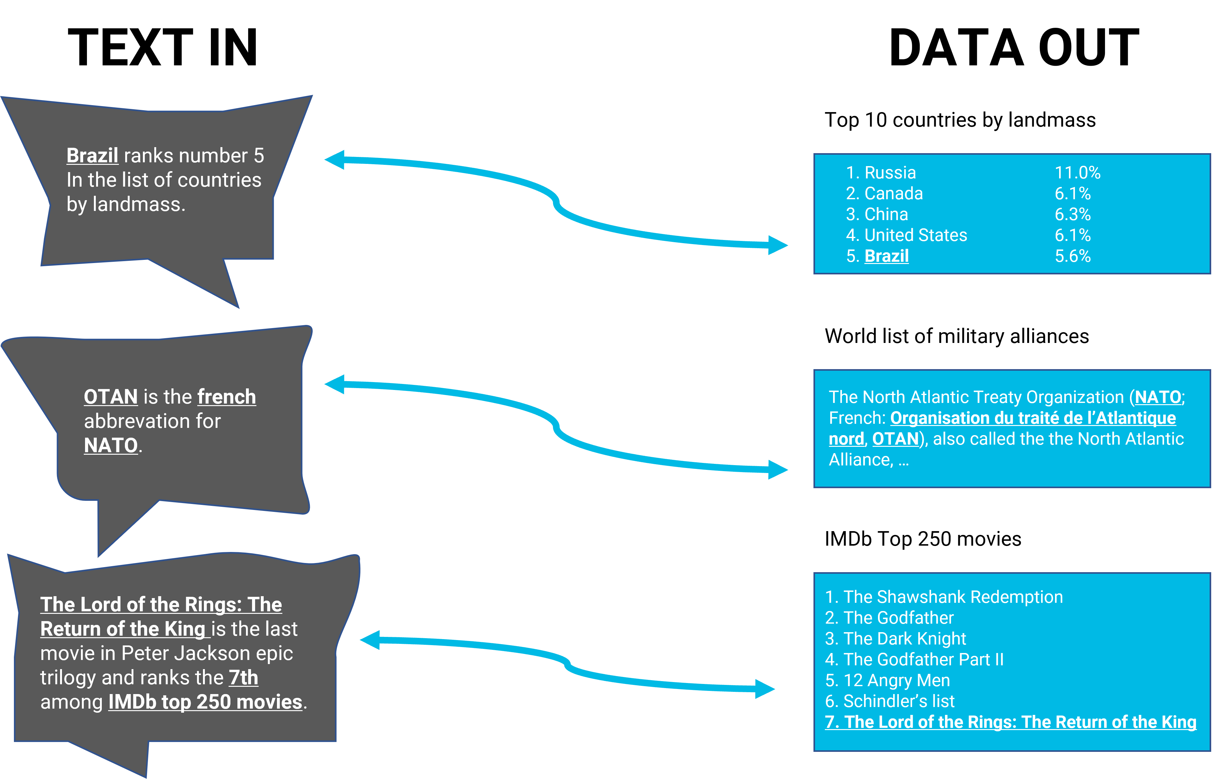
Information Extraction
Information extraction (IE) is the task of automatically extracting structured information from unstructured and/or semi-structured machine-readable documents and other electronically represented sources. Typically, this involves processing human language texts by means of NLP. Recent activities in multimedia document processing like automatic annotation and content extraction out of images/audio/video/documents could be seen as information extraction.

Slide 24
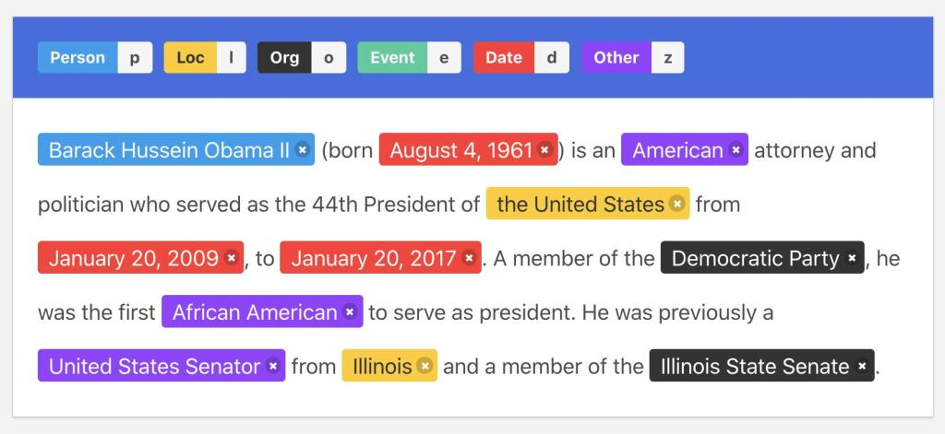
Named-Entity Recognition
Named-entity recognition is a subtask of information extraction that seeks to locate and classify named entities mentioned in unstructured text into pre-defined categories such as person names, organizations, locations, medical codes, time expressions, quantities, monetary values, percentages, etc.

Slide 25
Similarity Measures
Levenshtein - the number of characters that must be deleted, inserted, or substituted in order to make a pair of strings equal
Jaccard - the measure of overlap between 2 sets; in the case of NLP, generally, documents are sets of words
Smith Waterman - similar to Levenshtein, but with costs assigned to substitution, insertion, and deletion

Slide 26
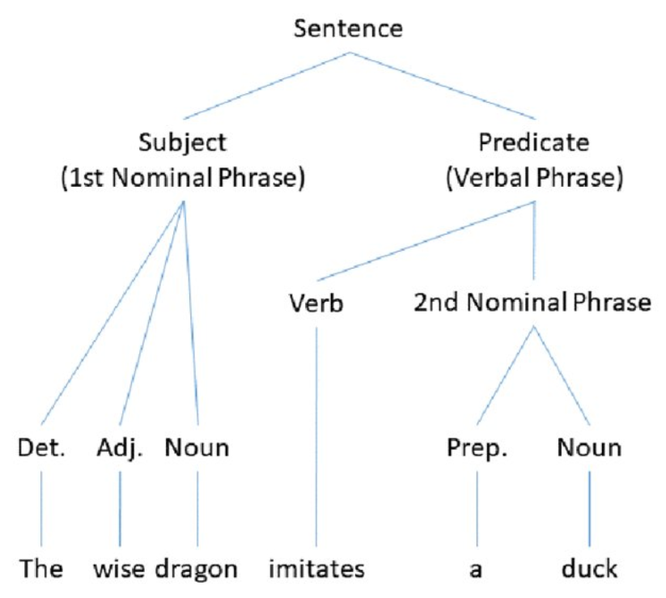
Syntactic Analysis
Also referred to as parsing, syntactic analysis is the process of analyzing the strings of symbols in natural language in conformance with grammatical rules.
Levels of syntactic analysis:
POS tagging
Constituency parsing
Dependency parsing
Notes:
- Syntactic analysis syntactic analysis analyzes the relationship between words and the grammatical structure of sentences using the rules of a formal grammar.
- take an example to show the order and word relationship matter.
- Levels:
+ Constituency parsing: identifying the noun phrases, verb phrases, and other constituents, and then determining the relationships between them
+ Dependency: concern about dependencies between words. Dependency parsing focuses on identifying the grammatical relationships between words in a sentence, such as subject-verb relationships

Slide 27
Semantic Analysis
Semantic analysis is interested in determining the meaning of text selections (either character or word sequences). After an input selection of text is read and parsed (analyzed syntactically), the text selection can then be interpreted for meaning.
Simply put, syntactic analysis is concerned with what words a text selection was made up of, while semantic analysis wants to know what the collection of words actually means.

Slide 28

Sentiment Analysis
Sentiment analysis is the process of evaluating and determining the sentiment captured in a selection of text, with sentiment defined as feeling or emotion. This sentiment can be simply positive (happy), negative (sad or angry), or neutral, or can be some more precise measurement along a scale, with neutral in the middle, and positive and negative increasing in either direction.

Slide 29
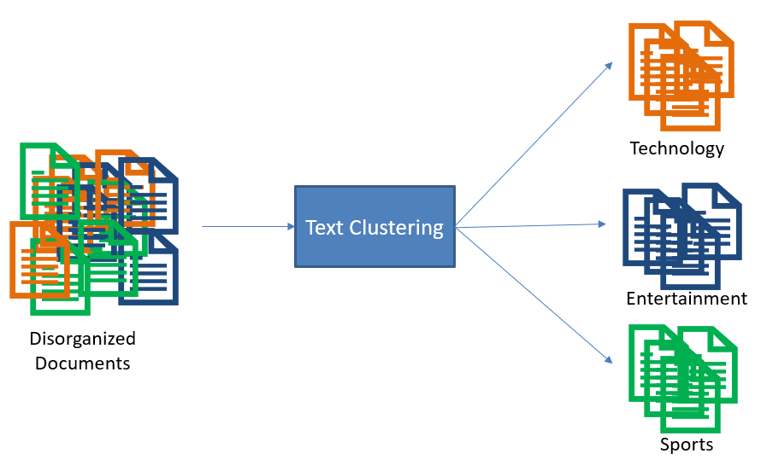
Text Clustering
Text clustering is the process of grouping similar documents together based on their content. By clustering text, we can identify patterns and trends that would otherwise be difficult to discern.

Slide 30
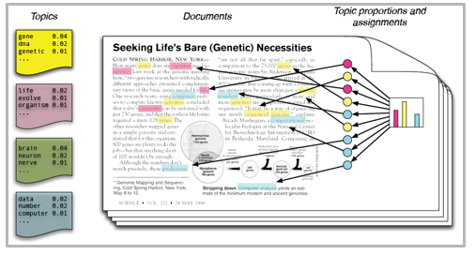
Topic Modeling
Topic modeling is a type of statistical modeling for discovering the abstract “topics” that occur in a collection of documents.
Topics can be defined as “a repeating pattern of co-occurring terms in a corpus”. A good topic model should result in – “health”, “doctor”, “patient”, “hospital” for a topic – Healthcare, and “farm”, “crops”, “wheat” for a topic – “Farming”.

Slide 31
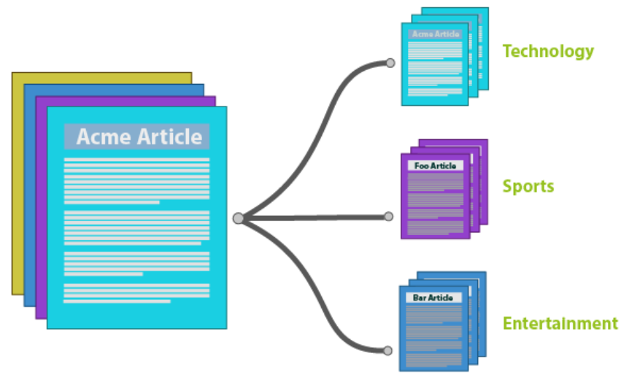
Text Classification
Text classification is the process of assigning tags or categories to text according to its content. It’s one of the fundamental tasks in Natural Language Processing (NLP) with broad applications such as sentiment analysis, topic labeling, spam detection, and intent detection.
Notes:
Intent Detection is a task of determining the underlying purpose or goal behind a user's search query given a context. The task plays a significant role in search and recommendations.

Slide 32

Machine Translation
Machine translation is the task of automatically converting source text in one language to text in another language.
In a machine translation task, the input already consists of a sequence of symbols in some language, and the computer program must convert this into a sequence of symbols in another language.

Slide 33
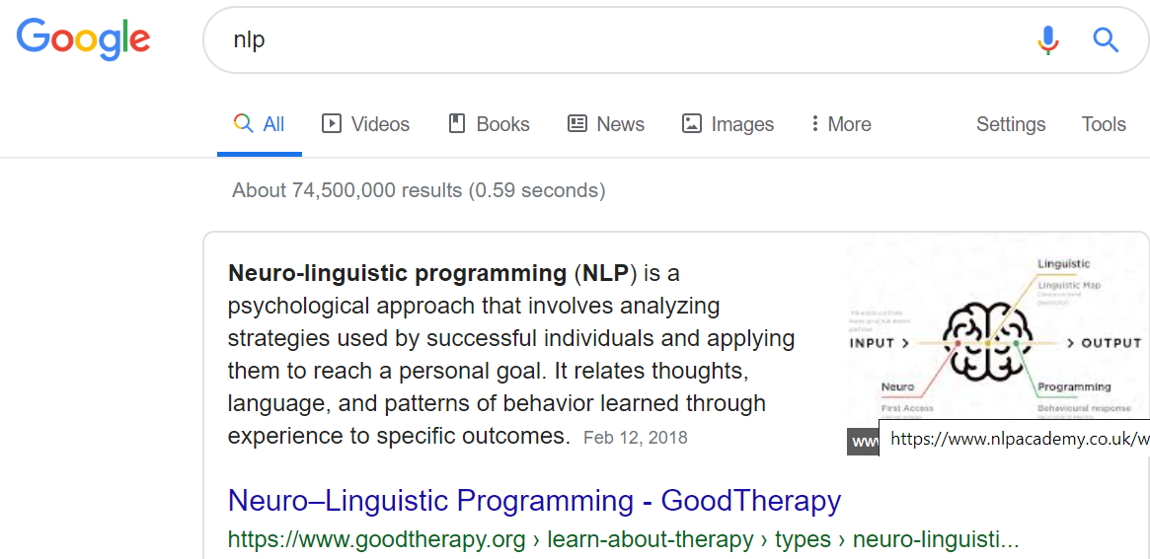
Information Retrieval
Information retrieval (IR) is finding material (usually documents) of
an unstructured nature (usually text) that satisfies an information need from within large collections (usually stored on computers).
https://nlp.stanford.edu/IR-book/pdf/01bool.pdf

Slide 34
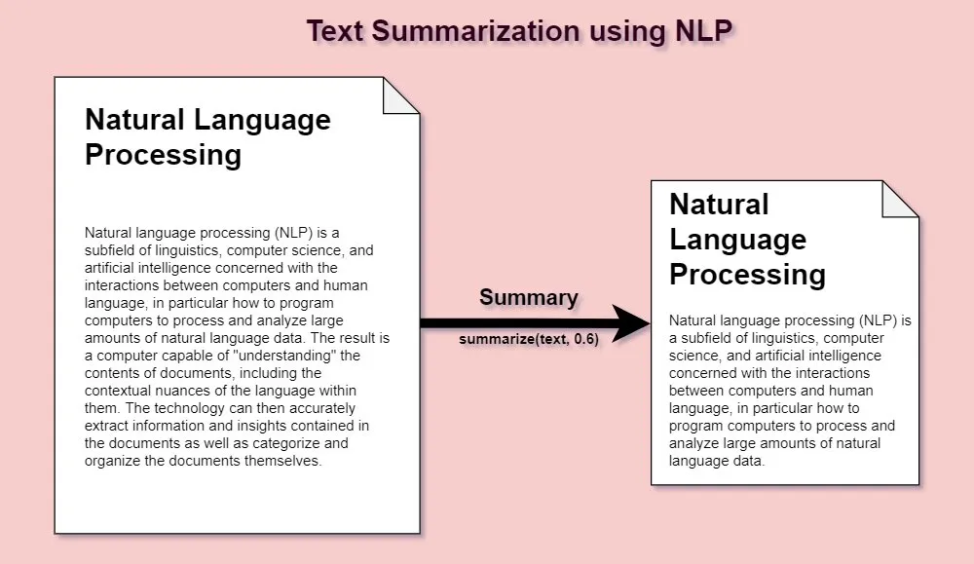
Text Summarization
Text Summarization is an NLP task that involves condensing a lengthy text document into a shorter, more compact version while still retaining the most important information and meaning. The goal is to produce a summary that accurately represents the content of the original text in a concise form.

Slide 35
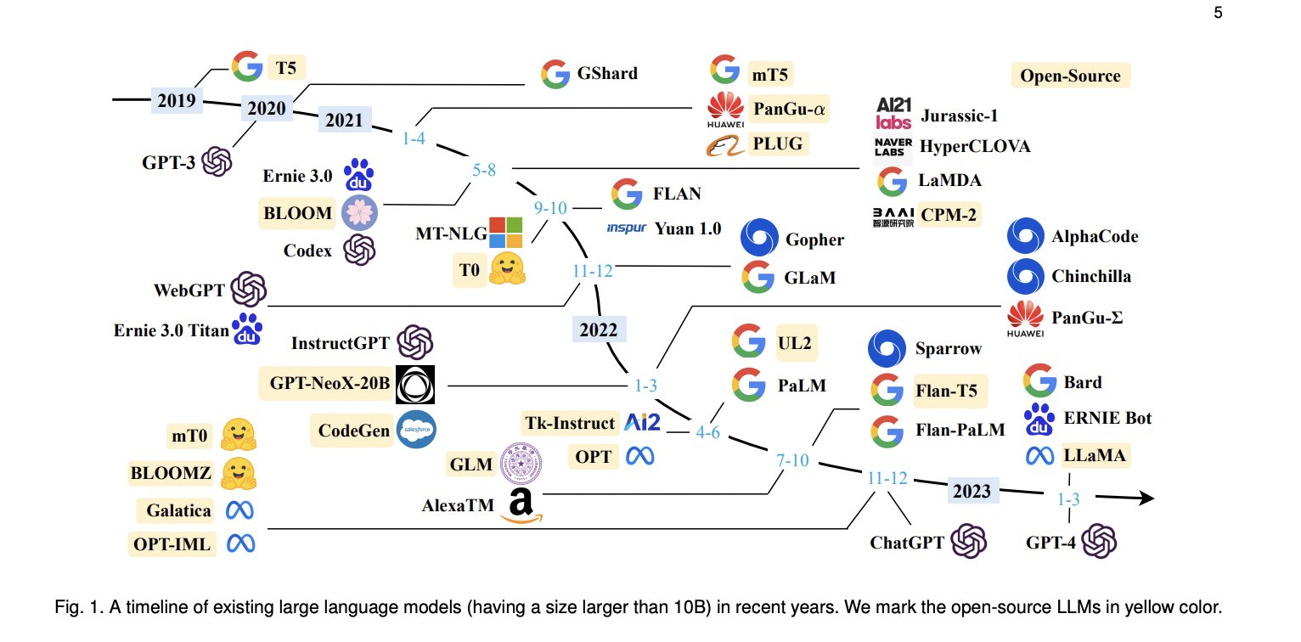
Large language models (LLMs)
Large language models (LLMs) are deep learning algorithms that can recognize, summarize, translate, predict, and generate text and other forms of content based on knowledge gained from massive datasets.
https://www.youtube.com/watch?v=UCg8W236vfw&t=12s
https://www.youtube.com/watch?v=0pHi6h1DyvQ

Slide 36
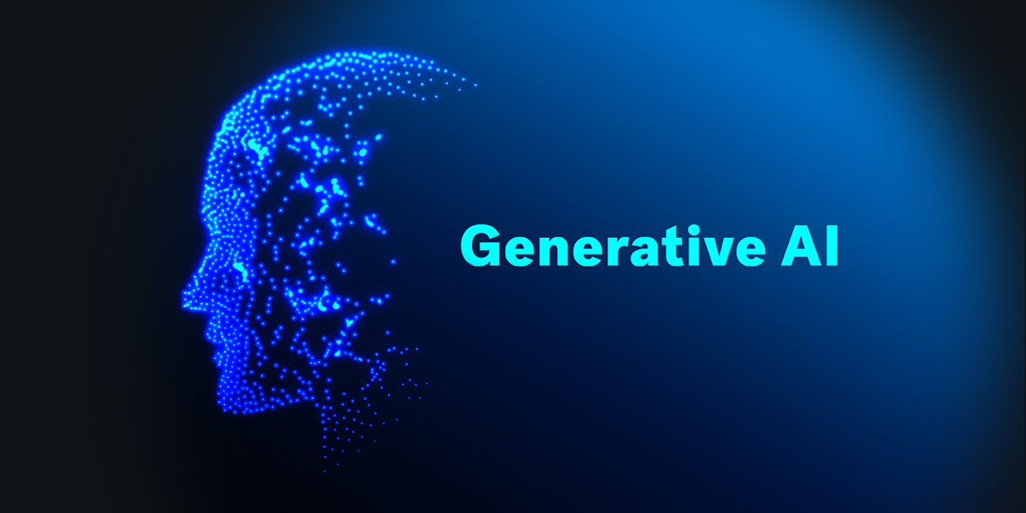
Generative AI
Generative AI refers to systems that can create different types of content, including text, images, and code by extrapolating from patterns learned from being trained on vast swathes of data.
ChatGPT, Claude AI, Google Bard AI, Bing AI Chat, Perplexity AI, OpenAI GPT Playground, Poe by Quora, YouChat, Chatsonic, and others

Slide 37
Thank you

